Slide 1
CHAPTER
1 Economic Models

Slide 2
Theoretical Models
Economic models
  Used by economists to describe economic activities
  Most are abstractions from reality
  Provide aid in understanding economic behavior

Slide 3
Verification of Economic Models
Two general methods used to verify economic models:
  Direct approach
    Establishes the validity of the model’s assumptions
  Indirect approach
    Shows that the model correctly predicts real-world events

Slide 4
Verification of Economic Models
Using the profit-maximization model to examine these approaches
  A firm seeks to maximize profit under certain assumption
  Testing assumptions
    Do firms really seek maximum profits?
  Testing predictions (compare against data)
  Importance of empirical analysis
    To learn something about the real world

Slide 5
General Features of Economic Models
Ceteris Paribus assumption
  “Other things the same”
  Economic models explain simple relationships
    Focus on only a few forces at a time
    Other variables are assumed to be unchanged

Slide 6
General Features of Economic Models
Structure of Economic Models
  Highlight the relationships between factors that affect the decisions of households and firms and the results of those decisions
Exogenous variables
  Are outside of a decision-maker’s control
Endogenous variables
  Determined within our models

Slide 7
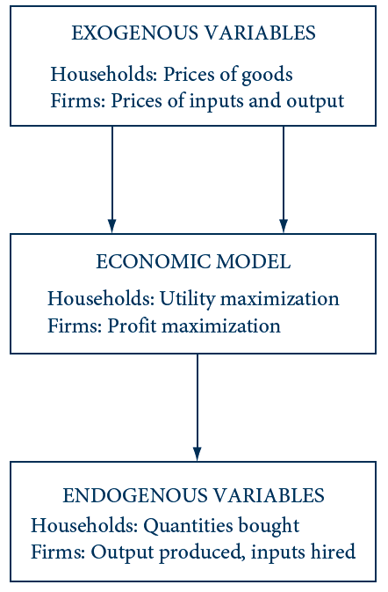
1.1 Structure of a Typical Microeconomic Model
Values for exogenous variables are inputs into most economic models.
Model outputs (results) are values for the endogenous variables.

Slide 8
General Features of Economic Models
2. Optimization assumption
  Economic actors are rationally pursuing a goal
    Consumers: maximize utility
    Firms: maximize profits (or minimize costs)
    Government regulators: maximize public welfare
  Generate precise, solvable models
  Optimization models appear to perform fairly well in explaining reality

Slide 9
1.1 Profit Maximization
A firm can sell all the output that it wishes at an exogenously determined price of p per unit
  Total costs of production, C, depend on the amount produced, q
Profits = π = pq – C(q)
The profit-maximization output level, q*
  First-order condition
    Output level for which price is equal to marginal cost, C’(q)
  Second-order condition
    Marginal cost must be increasing at q*

Slide 10
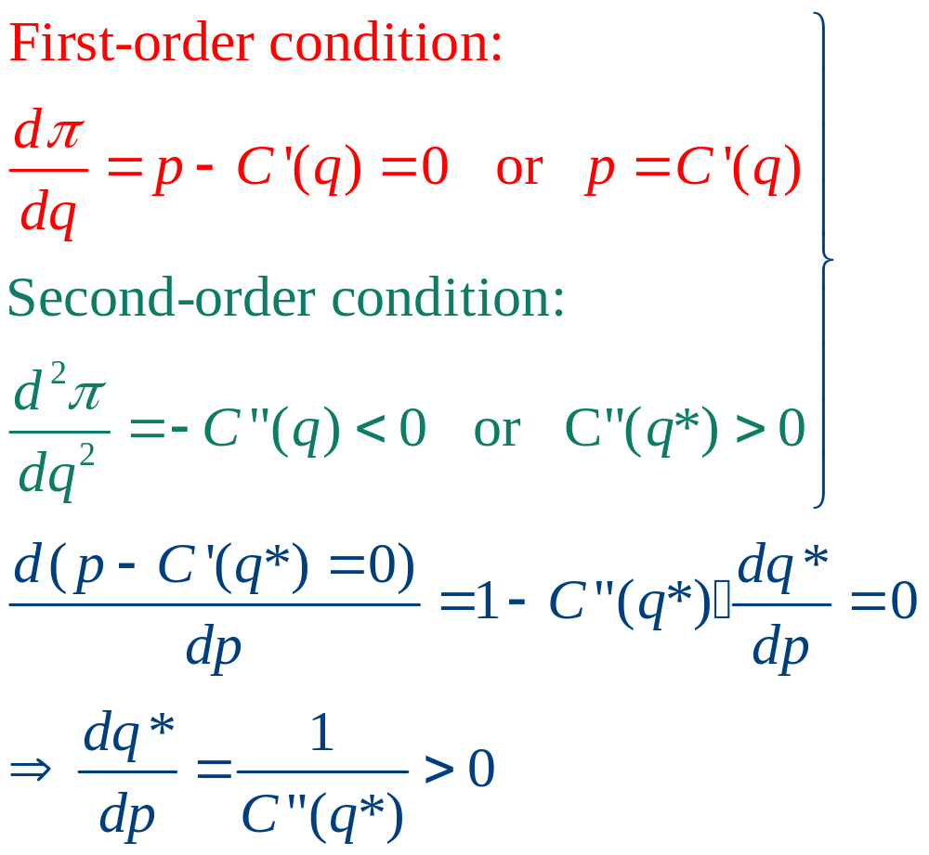
1.1 Profit Maximization

Slide 11
General Features of Economic Models
3. Positive-normative distinction
Positive economic theories
  Seek to explain the economic phenomena that are observed
Normative economic theories
  Focus on what “should” be done

Slide 12
The Economic Theory of Value
Early economic thoughts on “value”
  “Value” was considered to be synonymous with “importance”
  The price of an item may differ from its value
  Establish the idea of a “just price” for some items and examine how actual market prices conformed to this ideal

Slide 13
The Economic Theory of Value
The founding of modern economics
  The wealth of nations by Adam Smith is considered the beginning of modern economics
  Finding a way to describe the relationship between value and price
    Value meant “value in use”
    Price meant “value in exchange”
    Water-diamond paradox

Slide 14
The Economic Theory of Value
Labor theory of exchange value
  The exchange values of goods are determined by the costs of producing them
    Primarily affected by labor costs
  Diamond-water paradox
    Producing diamonds requires more labor than producing water

Slide 15
The Economic Theory of Value
The marginalist revolution
  The exchange value of an item is determined by the usefulness of the last unit consumed
    Since water is plentiful, consuming an additional unit has a relatively low value

Slide 16
The Economic Theory of Value
Marshallian supply-demand synthesis
  Supply and demand simultaneously operate to determine price
  Prices reflect both the marginal valuation that consumers place on goods and the marginal costs of producing the goods

Slide 17
1.2 The Marshallian Supply–Demand Cross
Price
Equilibrium
q_{D} = q_{s}
S
The supply curve has a positive
slope because marginal cost
rises as quantity increases
p*
The demand curve has a negative slope because the marginal value falls as quantity increases
D
q*
Quantity per period
Marshall theorized that demand and supply interact to determine the equilibrium price (p*) and the quantity (q*) that will be traded in the market. He concluded that it is not possible to say that either demand or supply alone determines price or therefore that either costs or usefulness to buyers alone determines exchange value.

Slide 18
1.2 Supply-Demand Equilibrium
Quantity demanded = q_{D} = 1000 - 100p
Quantity supplied = q_{S} = -125 + 125p
Equilibrium ⇒ q_{D} = q_{S}
1000 - 100p = -125 + 125p
225p = 1125
p* = 5
q* = 500

Slide 19
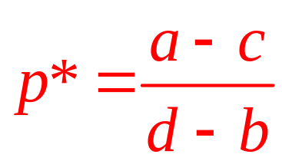
1.2 Supply-Demand Equilibrium
A more general model is
q_{D} = a + bp
q_{S} = c + dp
Equilibrium ⇒ q_{D} = q_{S}
a + bp = c + dp

Slide 20
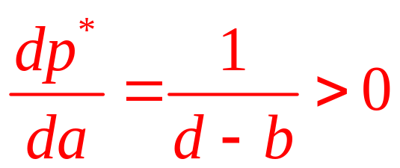
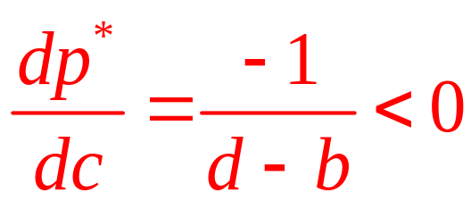
1.2 Supply-Demand Equilibrium
What happens to the equilibrium price if either demand or supply shift?
  An increase in demand (an increase in a) increases equilibrium price
  An increase in supply (an increase in c) reduces price

Slide 21
1.2 Supply-Demand Equilibrium
A shift in demand will lead to a new equilibrium:
q’_{D} = 1450 - 100p
q’_{D} = 1450 - 100p = q_{S} = -125 + 125p
225p = 1575
p* = 7
q* = 750

Slide 22
1.3 Changing Supply–Demand Equilibria
Price ($)
An increase in demand...
S
…leads to a rise in the
equilibrium price and
quantity.
7
5
D’
D
500
750
Quantity per period (bushels)
The initial supply–demand equilibrium is illustrated by the intersection of D and S (p* = 5, q* = 500). When demand shifts to q_{D’} =1; 450 - 100p (denoted as D’), the equilibrium shifts to p*= 7, q*=750.

Slide 23
The Economic Theory of Value
Paradox resolved
  Water
    Low marginal value
    Low marginal cost of production
    Low price
  Diamonds
    High marginal value
    A high marginal cost of production
    High price

Slide 24
The Economic Theory of Value
General equilibrium models
  The Marshallian model is a partial equilibrium model
    Focuses only on one market at a time
  For more general questions, we need a model of the entire economy
    Must include the interrelationships between markets and economic agents

Slide 25
The Economic Theory of Value
Production possibilities frontier
  Can be used as a basic building block for general equilibrium models
  Shows the combinations of two outputs that can be produced with an economy’s resources

Slide 26
1.4 Production Possibility Frontier
Quantity of food
per week
Opportunity cost of
clothing = 1/2 pound of food
A
10
9.5
Opportunity cost of
clothing = 2 pounds of food
B
4
2
3
4
12
13
Quantity of clothing
per week
The production possibility frontier shows the different combinations of two goods that can be produced from a certain amount of scarce resources. It also shows the opportunity cost of producing more of one good as the amount of the other good that cannot then be produced. The opportunity cost at two different levels of clothing production can be seen by comparing points A and B.

Slide 27
The Economic Theory of Value
Resources are scarce
  There are not enough resources available to produce all we might want of every good
Scarcity ⇒ we must make choices
  Each choice has opportunity costs
  Opportunity costs depend on how much of each good is produced
Welfare economics
  Desirability of various economic outcomes

Slide 28
1.3 A Production Possibility Frontier
An economy produces two goods, x and y
  Labor - the only input
  Production function for good x: x = l_{x}^{0.5}
    l_{x} is the quantity of labor used in x production
  Production function for good y: y = 2l_{y}^{0.5}
    l_{y} is the quantity of labor used in y production
  Total labor available: l_{x} + l_{y} ≤ 200
Production possibilities frontier:
l_{x} + l_{y} = x² + 0.25y² ≤ 200

Slide 29
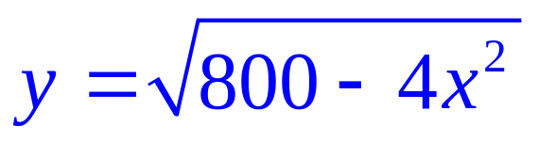
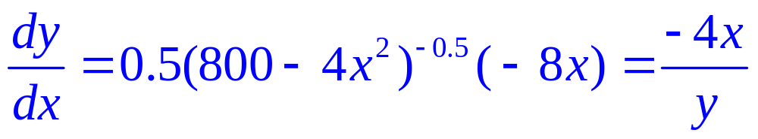
1.3 A Production Possibility Frontier
Opportunity cost of good y in terms of good x
  y² = 800 - 4 x², or
If we differentiate, we get
  When x = 10, y = 20, dy/dx = -4(10)/20 = -2

Slide 30
1.3 A Production Possibility Frontier
Concavity
  The slope of the frontier becomes steeper (more negative) as x output increases and y output decreases
    When x = 12, y ≈ 15, dy/dx = -4(12)/15 = -3.2
Inefficiency
  Economy operating inside its production possibility frontier
    20 workers are permanently unemployed
  x² + 0.25y² = 180
    When x = 10, then y ≈ 17.9

Slide 31
The Economic Theory of Value
Welfare economics
  ‘‘Economic efficiency’’
  Conditions under which markets will be able to achieve it
  Clarifying the relationship between the allocation pricing of resources
    Properly functioning markets provide an ‘‘invisible hand’’ that helps allocate resources efficiently

Slide 32
Modern Developments
The mathematical foundations of economic models
  Clarification and formalization of the basic assumptions that are made about individuals and firms
New tools for studying markets
  Creation of new tools to study markets

Slide 33
Modern Developments
Behavioral economics
  Make economic models more realistic
    Insights from psychology & other social sciences
  How imperfect information or various systematic biases
    Used to explain why decisions may not always conform to the “rational” assumptions

Slide 34
Modern Developments
The economics of uncertainty and information
  Incorporation of uncertainty and imperfect information into economic models
Computers and empirical analysis
  Increasing use of computers to analyze economic data and build economic models

